Slide 1
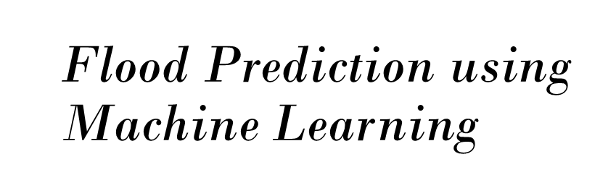


Slide 2
The Team
IBM Mentor
MR.SHAURYA SANDOO
Edunet Mentor
ARPITA ROY
Student Team
AASHIKA RAJ
ANOUSHKA DAS
ARCHANA KUMARI
MANJIMA BHATTACHARYYA
ROSHNI VERMA

Slide 3
Workload Division
Contribution of each team member in project
AB
CD
EF
GH

Slide 4
The Background
Include historic background about the problem and past/current scenarios

Slide 5
Problem Statement
Increasing frequency of severe floods
Devastating impacts on lives and property
Current prediction methods are insufficient
Need for more accurate and timely predictions
Integration of advanced technology is essential

Slide 6
Proposed Solution
Machine learning models for accurate predictions
Data integration from multiple sources
User-friendly website for accessing predictions
Real-time alerts and updates
Scalable system adaptable to different regions

Slide 7
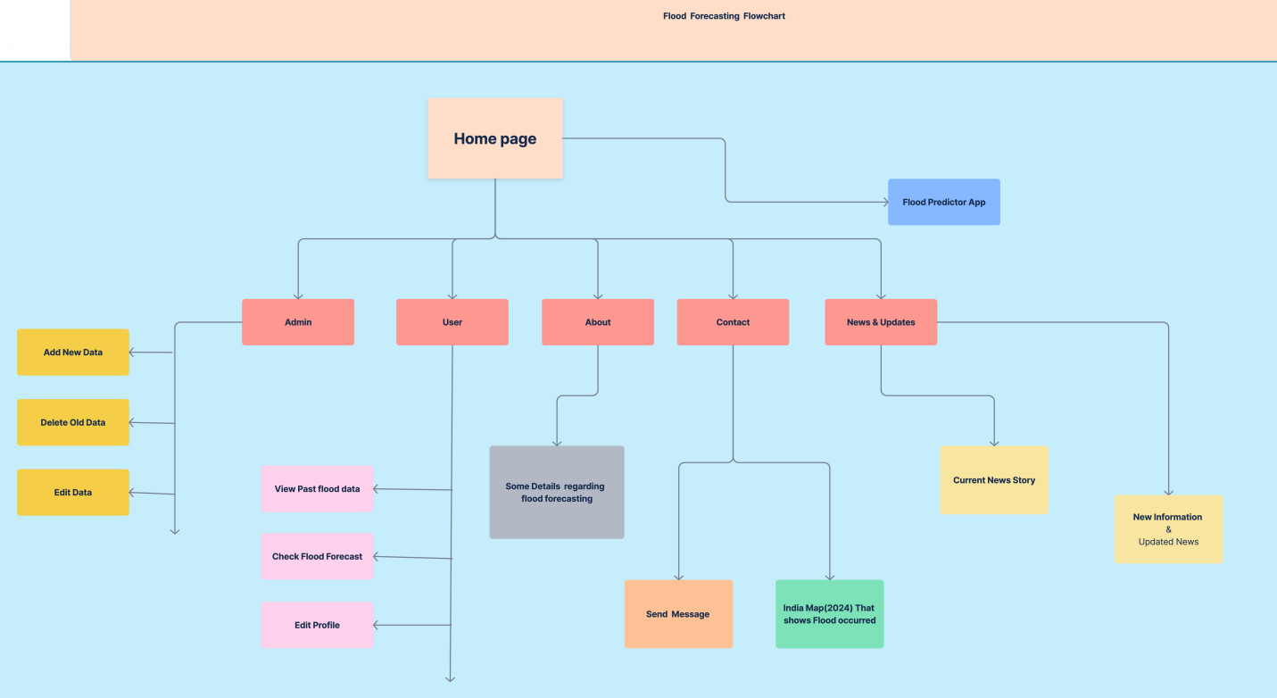
Solution Design

Slide 8
Technology Stack & Requirements
Machine Learning Algorithms: Random Forest, Neural Network, Decision Tree, RNN (Recurrent Neural Network),CNN (Convolutional Neural Network), Regression, K-Nearest Neighbors (KNN),LSTM (Long Short-Term Memory)
Web Development Technologies: HTML, CSS, JavaScript, Bootstrap
Python, Flask, Jupyter Notebook

Slide 9
Innovative Idea
Real-Time Data Integration: Integrate live data feeds from various sources such as weather stations, satellite imagery, and social media for more accurate and timely predictions.
Scenario-Based Modeling: Implement scenario-based simulations to predict how floods might evolve under different conditions, such as varying rainfall intensities or changes in land use.
User-Friendly Dashboard: Create an interactive and intuitive dashboard for users to visualize flood risks, historical data, and predictions. Incorporate features like customizable alerts, interactive maps, and scenario simulations.

Slide 10
Results/Outcomes/Analysis
Describe results, analysis or outcomes from the solution
State benefits of solution developed

Slide 11
Limitations
Limited Geographic Scope: The model currently focuses only on Mumbai and its specific areas, which limits its applicability to other regions that might have different factors influencing flood risks.
Lack of Real-Time Data Integration: The current model does not integrate real-time data feeds (e.g., live weather updates, river water levels) which are crucial for making timely and accurate flood predictions.
Infrastructure Data Limitations: Lack of detailed infrastructure data, like the quality and capacity of drainage systems or maintenance records, can hinder accurate predictions and risk assessments.
Lack of Adaptability to Climate Change: The model might not be fully equipped to adapt to changing climate patterns, which could alter flood risks over time in ways not accounted for by historical data.

Slide 12
Future Enhancements/Scope
Integration of Real-Time Data Sources: Implement real-time data integration from various sources such as weather forecasts, river water levels, satellite imagery, and IoT sensors in flood-prone areas.
Incorporation of Advanced Machine Learning Techniques: Utilize advanced machine learning techniques like ensemble learning, recurrent neural networks (RNNs), and transformers to better capture temporal patterns and dependencies in the data.
Community-based Reporting and Crowdsourcing: Develop a mobile application or web platform where community members can report local conditions, such as heavy rainfall or river overflow. This crowdsourced data can enhance model inputs with localized, ground-truth information, helping to refine predictions and provide early warnings.
Integration of Socio-Economic and Environmental Data: Include socio-economic factors (e.g., population density, infrastructure quality) and environmental data (e.g., soil saturation, vegetation cover) to assess the impact of potential floods more comprehensively.

Slide 13
The Demo showcasing the working solution/prototype

Slide 14
Thank You

